Slide 1
reviewable.io
Serious about code reviews?

Slide 2
Schedule
code reviews in general
reviewable.io: a quick introduction
reviewable.io: Hands-on

Slide 3


Slide 4
Code review
systematic examination of source code
Goals:
improve code quality
find mistakes overlooked in the developement process
check if code is tested

Slide 5
Formal code review
Traditional method of code reviews
Code reviewed line by line
Effective finding defects in code

Slide 6
Formal code review: problems
time consuming
preparation needed
difficult to organize
→ high overhead

Slide 7
Lightweight code review
Over-the-shoulder
Email pass-around
Pair programming
Tool-assisted code review

Slide 8
Lightweight code review: problems
impersonal
not everyone is integrated
easy to miss updates

Slide 9
Serious about code reviews?

Slide 10

Serious about code reviews?

Slide 11
Reviewable.io: Features
GitHub integration
dashboard with your personal reviews
public and private (only in the paid version) repositories supported
send comments in batches
tracks review progress

Slide 12
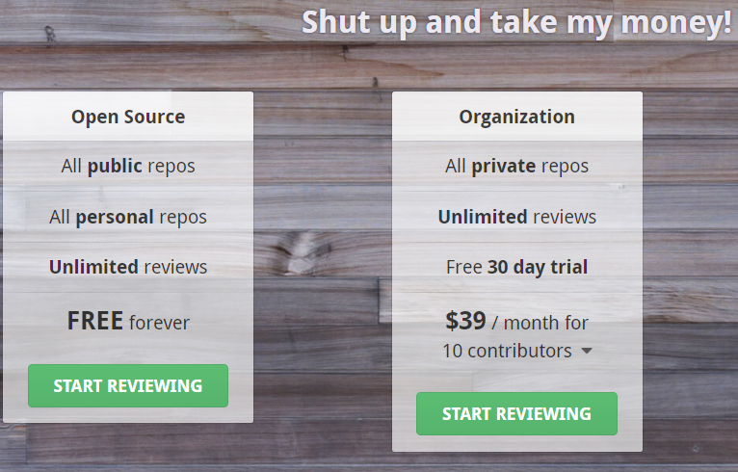
Pricing

Slide 13

Getting started
Sign in with Github

Slide 14
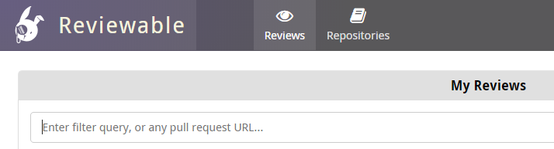
Getting started
Sign in with Github
Open tab „Repositories“

Slide 15
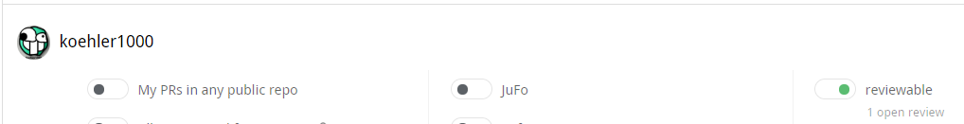
Getting started
Sign in with Github
Open tab „Repositories“
Check the wanted repositories

Slide 16
Getting started
Sign in with Github
Open tab „Repositories“
Check the wanted repositories
Visit your „Reviews“ tab

Slide 17
Demo
https://reviewable.io/reviews/Reviewable/demo/1

